Slide 1
Cognos8
Administration and Installation

Slide 2
Topics:
Overview of Cognos8 Architecture
Prerequisite to install Cognos8
Installation and Configuration of Cognos8
Security
Single Signon/ Portal Integration
Server Administration
Environment Sizing
Cognos Competency integration * intelligence * insight
Notes:
HCU EABIS
Cognos Competency
This slide shows the Table of Contents. They are
About Analysis Studio
Creating a Basic Analysis report
Working with Data in the Crosstabs
How to Explore Data
Limiting Data
Calculating Data
Different ways of Sharing Data
Drillthrough from Analysisstudio to Reportstudio
Drillthrough from Analysisstudio to Analysisstudio

Slide 3
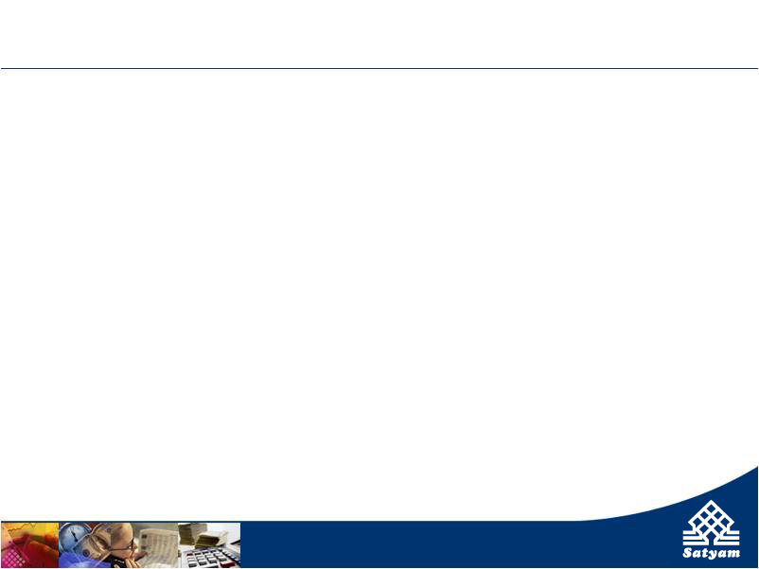
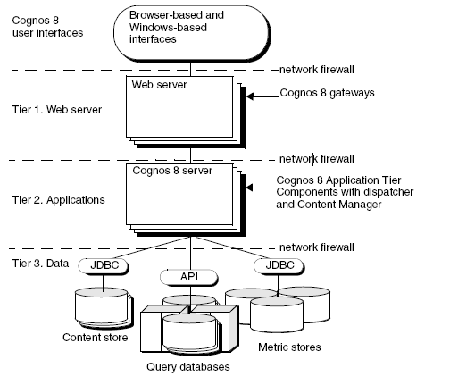
Cognos 8 Multi-tier Architecture
Cognos Competency integration * intelligence * insight
Notes:
Cognos 8 Business Intelligence is built with a single, modern Web services architecture.
Modern, multi-tier architecture built using open, modern Web standards such as XML, SOAP, and WSDL.
Common zero-footprint, browser-based environment requires no desktop installs, plug-ins, or applets.
Single point of update; deploy changes to all users simultaneously
Cognos 8 has a multi-tier architecture.
The multi-tier architecture has been separated to 3 tiers :
Web Server
Applications
Data
The tiers are based on business function, and are typically separated by network firewalls.

Slide 4
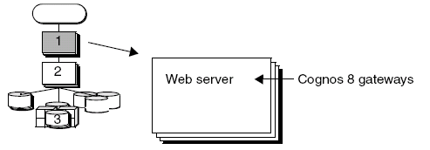
Tier 1. Web Server: Cognos 8 Gateways
Cognos Competency integration * intelligence * insight
Notes:
A gateway is an extension of a Web server program that transfers information from the Web server to another server.
Cognos 8 supports several types of Web gateways, including
1. CGI
2. ISAPI
3. Apache_Mode
4. Servlet

Slide 5
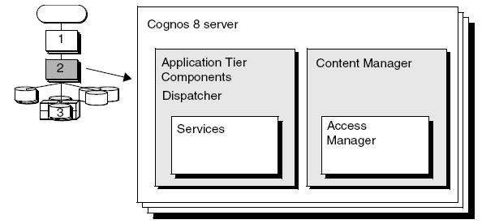
Tier 2. Applications: Cognos 8 Servers
Cognos Competency integration * intelligence * insight
Notes:
The Cognos 8 applications tier contains one or more Cognos 8 servers.
A Cognos 8 server runs requests, such as reports, analyses, and queries, that are forwarded by a gateway.
A Cognos 8 server also renders the Cognos Connection and Metric Studio interfaces.
Each Cognos 8 installation includes
- Application Tier Components, which include a dispatcher, that operates services and routes requests
- Content Manager, which manages Cognos 8 information

Slide 6
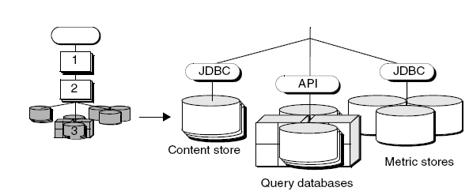
Tier 3. Data: Content Providers
Cognos Competency integration * intelligence * insight
Notes:
The Cognos 8 data tier contains the
Content Store
Data Sources
Metric Store
Content Store :
The content store is a relational database that contains data that Cognos 8 needs to operate, such as report specifications, published models, and the packages that contain them; connection information for data sources.
Data Sources:
Data sources are relational databases, dimensional cubes, files, or other physical data stores that can be accessed through Cognos 8.
Metric Store:
A metric store is a relational database that contains content for metric packages. A metric store also contains Metric Studio settings, such as user preferences.

Slide 7
Prerequisite to install Cognos8
Requirement | Specification
Operating System | Windows Unix - Sun Solaris - HP-UX - IBM AIX Linux
RAM | Minimum 2 GB
Disk space | Minimum: 2.5 GB of free space to install the software and 1 GB of free space on the drive that contains the temporary directory used by Cognos components.
JRE | JRE is installed automatically with Cognos 8 on Windows.
Web server | A Web server installed and started
Content Store Database | One of the following databases available to store Cognos data. Database ● Oracle ● DB2 ● Microsoft SQL Server ● Sybase
Cognos Competency integration * intelligence * insight

Slide 8
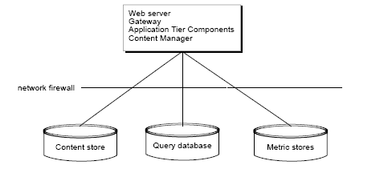
Installation of Cognos8
Installing All Components on One Computer :-
Cognos Competency integration * intelligence * insight
Notes:
The gateway must be located with the Web server, the single computer must also be running a Web server.
This also called as stand alone installation. This installtion help for development environment where we want to develop reports. Also we require such kind of installation for RND purposes.

Slide 9
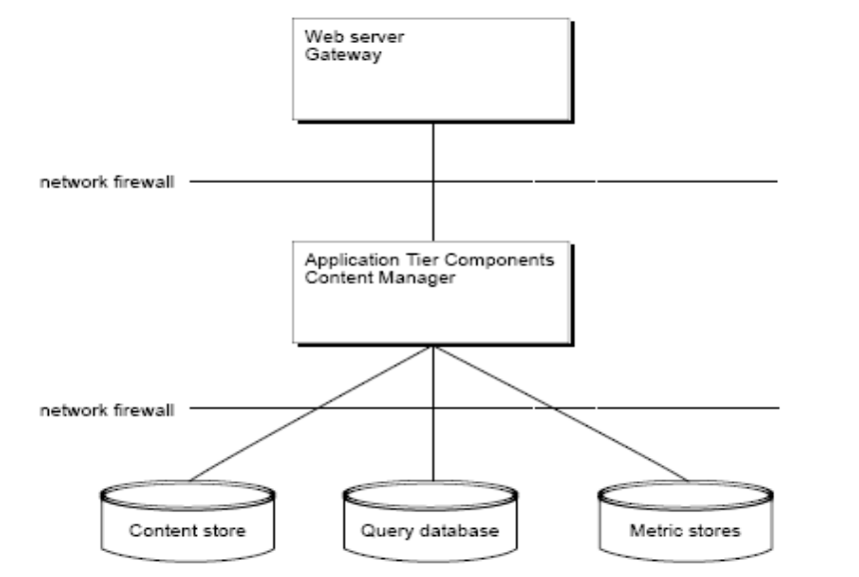
Installation of Cognos8
Installing the Gateway on a Separate Computer :-
Cognos Competency integration * intelligence * insight
Notes:
If you install only the gateway component on the same computer as the Web server, your Web server manages the core Web services and does not process user requests. This separation of processing may be required if you have a network firewall between the Web server and your
Application Tier Components computers.

Slide 10
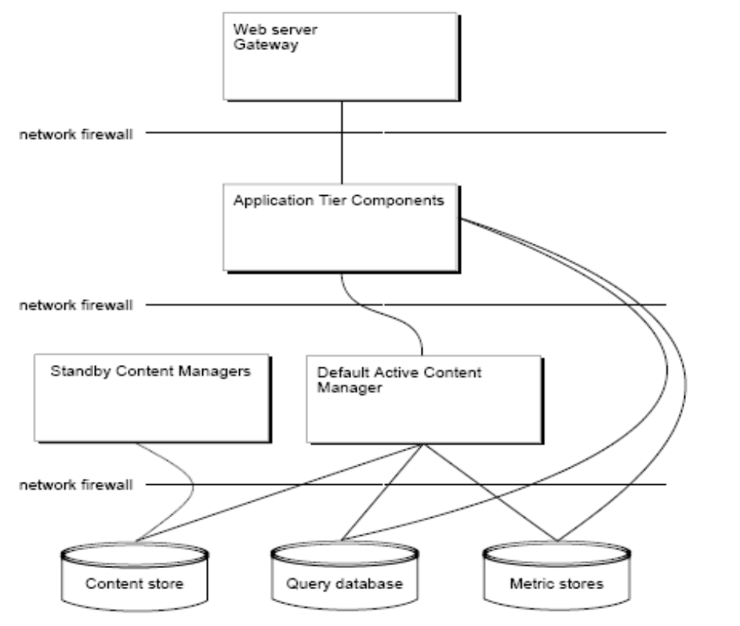
Installation of Cognos8
Installing Application Tier Components and Content Manager on Separate Computers :-
Cognos Competency integration * intelligence * insight
Notes:
To get the more performance install Content Manager install on separate machine. In this type of environment, Cognos 8 scalability can be improved
by increasing the size of the processor on which Content Manager is installed.
Here incoming requests are routed to a gateway. The gateway forwards the request to the Application Tier Components computer. The Application Tier Components computer forwards it to the active Content Manager computer, which queries the content store and sends the
results back to the Application Tier Components computer for rendering.

Slide 11
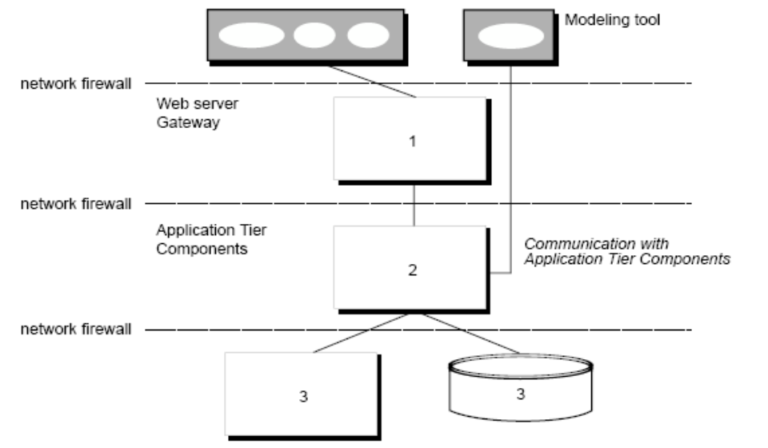
Installation of Cognos8
Installation of Modeling Tools:- Framework Manger , Metric Designer and Transformer.
Modeling Tool communicate with Application Tier by configuring cryptographic properties and by following two environment.
    Gateway
    Dispatcher URI
Framework Manger
Transformer
Metric Designer
Cognos Competency integration * intelligence * insight
Notes:
Web Servers Other Than Microsoft IIS
For Web servers other than Microsoft Internet Information Services (IIS), no functional difference exists between the two communication routes between the modeling tool and the Application Tier Components dispatcher. For either route, the modeling tool uses the BI Bus SOAP API. If you use the Web server route, and you have medium-sized and large models (approaching 1 MB in size), the models are broken into smaller pieces (chunked) for transmission.
If you use a Web server other than Microsoft IIS, we recommend that you configure the modeling tool to communicate through your Web server gateway (Route 1). This eliminates the need to set up additional communications channels if you use firewalls to separate the modeling tool, your Web server, and your Application Tier Components.

Slide 12
Cognos8 Configuration
Environment Configuration
Group Properties
Cognos8 Services
2. Security
Authentication
3. Data Access
Content store
Cognos Competency integration * intelligence * insight
Notes:
Environment Cofiguration :- By configuring this property we can communicate with the other Cognos 8 component s installed on remote computer.
Security : Configure these properties to ensure secure communication between Cognos8 components, to set the security environment that all users share, and to enable encryption.
Data Access : This property can use an external database to store Cognos8 application content and security information.

Slide 13
Cognos8 Configuration
Cognos8 Services
To improve the performance one can change the resource type from cognos8 services. By default it is Small Configuration.
There are 3 types of Resource type setting .
Small configuration : To reduce the startup time, memory footprint, and resources used.
Medium configuration : Want a balance between fast startup time and quick operating speeds
Large configuration : Want to maximize operating speeds and if performance is more important than fast startup time, and if your computer has a lot of resources
Cognos Competency integration * intelligence * insight

Slide 14
Cognos8 Configuration
Authentication
  Two types of access to cognos8
  Anonymous and Authenticated.
  Default Enable Option :- Anonymous
  To logon on the user to cognos 8 one should disable anonymous access
  Cognos support following type of Namespace Type
  Active Directory
  Cognos Series 7
  Custom Java Provider
  LDAP
  NTLM
  SAP
  Netegrity SiteMinder
Cognos Competency integration * intelligence * insight

Slide 15
Cognos8 Configuration
Content Store: -The content store is a database that Content Manager uses to store global configuration data, global settings (such as the language and currency formats shown in the user interface), connections to
data sources, and product-specific content. Design models and log files are not stored in the content
store.
Cognos Support following database to create Content Store Database
● Microsoft SQL Server
● Oracle
● DB2
● Sybase
Cognos Competency integration * intelligence * insight
Notes:
For SQL server :- SQL server 7 and 2000
For Oracle :- character set parameters should be AL32UTF8 or UTF-8
For DB2 :- Following variable to be set
DB2DIR : The top level directory that contains the database client software or the entire database installation.
libraryPATH : The load library path. You must add driver location. Please see below example -
LD_LIBRARY_PATH (On Solaris) :- Solaris example: LD_LIBRARY_PATH= $DB2DIR/lib:$LD_LIBRARY_PATH

Slide 16
Security Architecture
Content Store: -The content store is a database that Content Manager uses to store global configuration data, global settings (such as the language and currency formats shown in the user interface), connections to
data sources, and product-specific content. Design models and log files are not stored in the content
store.
Cognos Support following database to create Content Store Database
● Microsoft SQL Server
● Oracle
● DB2
● Sybase
Cognos Competency integration * intelligence * insight
Notes:
For SQL server :- SQL server 7 and 2000
For Oracle :- character set parameters should be AL32UTF8 or UTF-8
For DB2 :- Following variable to be set
DB2DIR : The top level directory that contains the database client software or the entire database installation.
libraryPATH : The load library path. You must add driver location. Please see below example -
LD_LIBRARY_PATH (On Solaris) :- Solaris example: LD_LIBRARY_PATH= $DB2DIR/lib:$LD_LIBRARY_PATH

Slide 17
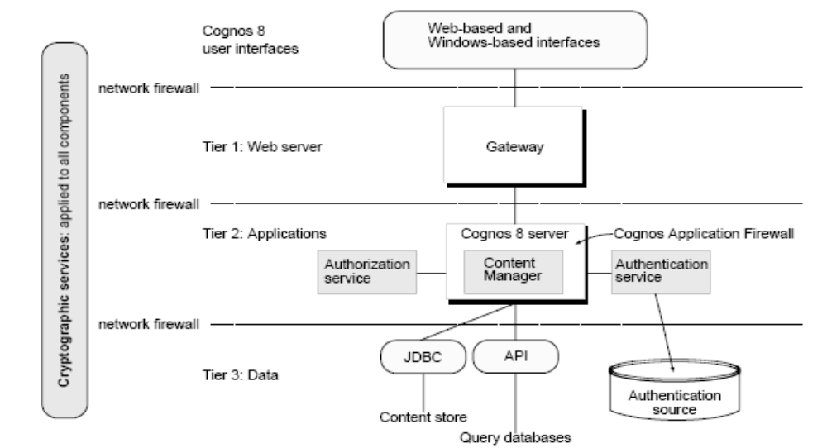
Cognos8 Security
Cognos8 Security involves following
● Cognos Application Firewall
● Cognos authentication services
● Cognos authorization services
● Cryptographic services
integration * intelligence * insight
Notes:
Cognos Application Firewall : Cognos Application Firewall validates and filters incoming and outgoing traffic at the dispatcher layer. Cognos Application Firewall features include request validation, Secure Error, and parameter signing. Cognos Application Firewall is an essential component of Cognos 8 security, helping to provide protection against penetration vulnerabilities such as cross-site scripting.
Cognos authentication services : Authentication is the process of identifying individuals before allowing them to log on. Authentication in Cognos 8 is integrated with third-party authentication providers. Authentication providers define users, groups, and roles used for authentication.
To set up authentication for Cognos 8, you must configure Cognos 8 using one or more of these authentication providers:
● LDAP
● Windows NT LAN Manager (NTLM)
● Microsoft Active Directory
● Cognos 7 namespaces
● SiteMinder
● Custom Java provider
Cognos authorization services :Authorization is the process of granting or denying access to data, and specifying the actions that can be performed on that data, based on a user identity. For example, Cognos 8 administrators can set up folders in which reports are stored. They can then secure those folders so that only authorized users can view, change, or perform other tasks using the reports in the folder.
Cryptographic services :Cryptographic services ensure that Cognos 8 communications and sensitive data are secure.
Encryption is used to secure
● static data
● temporary data
● transient data

Slide 18
Users, Groups, and Roles
Users, groups, and roles are created for authentication and authorization purposes.
User :- A user entry is created and maintained in a third-party authentication provider to uniquely identify a human or a computer account. You cannot create user entries in Cognos 8.
Groups and Roles :- Groups and roles represent collections of users that perform similar tasks, or have a similar status in an organization. Examples of groups are Employees, Developers, or Sales Personnel. Members of groups can be users and other groups.
Cognos Competency integration * intelligence * insight

Slide 19
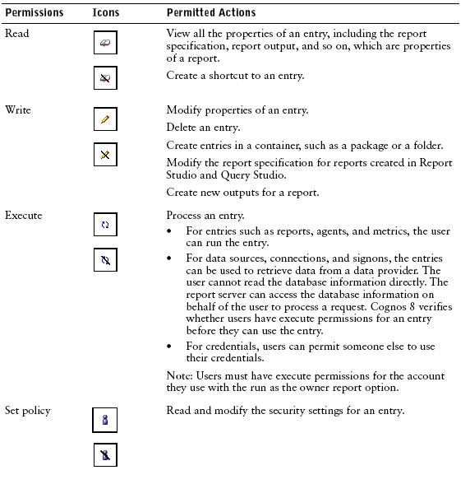

Access Permissions
You can grant or deny the following access permissions.
Cognos Competency integration * intelligence * insight

Slide 20
Single Sign on/ Portal Integration
Enterprise User @ Portal
User Interface layer
Primary Authentication @ Portal
Single Sign On
Cognos 8 BI Server
Secondary Authentication @ COGNOS
COGNOS Security Mgmt.
Cognos Reports
Cognos Framework Manager Packages
COGNOS Access Layer
Solution Highlights
Primary Authentication to Enterprise portal is done through Custom Authentication.
If the user is not authenticated , then Custom Authentication provider does not allow the users to Access the Portal. It Prompts user to contact Portal Administrator for Access.
The secondary authentication is done thru COGNOS Security Mgmt.
Valid Cognos users does not have to reenter COGNOS credentials.
Cognos Competency integration * intelligence * insight

Slide 21
Server Administration
Dispatchers and Services
Log Messages
Deployment
Audit Reports
Portal Services Administration
Performance Monitoring and Tuning
Cognos Competency integration * intelligence * insight

Slide 22
Dispatchers and Services
Dispatchers and Services
• Balance Requests Among Dispatchers
• Use cluster compatible mode for dispatchers
• Setting the number of processes and connections
• Enable session caching
• Maximizing usage during peak periods
• Setting queue time limits
Cognos Competency integration * intelligence * insight
Notes:
Balance Requests Among Dispatchers : If your installation includes more than one dispatcher, you can specify the proportion of requests that each dispatcher handles by changing their processing capacity. This is commonly referred to as load balancing. You typically set the capacity for a dispatcher based on the CPU speed of the computer where it is installed.
For example, a first dispatcher is installed on a 2 GHz computer and a second dispatcher on a 1 GHz computer. You set the processing capacity of the first dispatcher to 2.0 and the second to 1.0. The first dispatcher handles two-thirds of the requests while the second handles one-third of the requests. If you set the capacity of both dispatchers to 1.0, requests are sent to each dispatcher alternately.
Use cluster compatible mode for dispatchers : If your Cognos 8 servers operate within a load balancing infrastructure, you can turn off the weighted round robin format of load-balancing for the dispatcher. Otherwise, load balancing may be duplicated by the cluster and by Cognos 8, which can degrade performance. You can set the dispatcher property named loadBalancingMode either to weightedRoundRobin or
clusterCompatible. In weightedRoundRobin mode, the dispatcher sprays requests in a weighted round fashion, according to the configuration settings for the dispatcher (p. 62). This is the default mode.
Set the Maximum Number of Processes and Connections : If the maximum number of processes or connections is set too high, many concurrent requests
compete for system resources and requests take longer to complete. The default number of batch report and report processes is two.
Low Affinity Connections : Typically, low affinity requests are used when a report is initially requested.
High Affinity Connections : Typically, high affinity requests are for a report that was already requested, and may include actions, such as going to the next page in a report..
Enable session caching: In Report Studio, Query Studio, and Cognos Viewer the results for previous requests to the database are cached for the duration of a session when session caching is enabled. To increase performance, for subsequent queries, Cognos 8 uses cached results for some actions rather than accessing the database. This applies when the same results can be used or when the new results are a subset of the cached results. The session cache feature is disabled by default.
Steps
1. Copy the c8_location/configuration/CQEConfig.xml.sample file to c8_location/bin and
rename it CQEConfig.xml.
2. Open the c8_location/bin/CQEConfig.xml in an editor.
3. Ensure that your editor supports saving files in UTF-8 format.
4. Find the queryReuse parameter and change the value to 1.
5. Save the CQEConfig.xml file.
6. Using Cognos Configuration, stop and then restart Cognos 8.
Maximizing usage during peak periods :Most organizations have a period of peak demand. This period is usually during business hours when employees are at work and run interactive reports. You can determine the start and end hours of the peak demand period for your organization. For this period, you can set the maximum number of concurrent jobs that can run.
Steps
1. In Cognos Connection, in the upper-right corner, click Tools, Server Administration.
2. Click the Monitor tab.
3. In the Actions column, click the set properties button for the service or configuration folder
you want.
4. Click the Settings tab to view all the configuration settings for that service or folder.
5. In the Value column, type new values for the following settings:
• Peak period start hour
• Peak period end hour
• Maximum jobs during peak period
• Maximum jobs during non-peak period
Tip: If you want to reset a configuration setting to its default value, select its check box and
click Reset to default value.
6. Click OK.
Setting queue time limits: You can specify the maximum number of seconds that interactive requests made by users wait in
the queue for an available report service connection. If a request cannot be processed within the
time limit, the request fails and users receive an error message.
If your operating system has adequate resources and Cognos 8 is properly configured, requests
should not take longer than the time limit.
When you specify a time limit, consider the maximum number of seconds that you want users to
wait for a response. The default queue time limit is 240 seconds.
Requests for the batch report service stay in the queue indefinitely.
To access the server administration tool, you must have execute permissions for the server
administration secured feature and traverse permission for the Administration secured function.
Steps
1. In Cognos Connection, in the upper-right corner, click Tools, Server Administration.
2. Click the Monitor or Configure tab.
3. In the Actions column, click the set properties button for the service or configuration folder
you want.
4. Click the Settings tab to view all the configuration settings for the service or folder.
5. In the Value column, type a new value for the Queue time limit of report service in seconds
setting.
Tip: If you want to reset a configuration setting to its default value, select its check box and
click Reset to default value.
6. Click OK.

Slide 23
Log Messages
Log messages are an important diagnostic tool for investigating the behavior of Cognos 8. All the Cognos 8 services send events to the log server, which directs messages to a log file. After an error or problem occurs, you can review the log messages to obtain clues as to what happened.
By default, log messages are saved to the crnserver.log file located in c8_location/logs.
Cognos Competency integration * intelligence * insight
Notes:
Steps to retrieve the full error details
1. Find the error code ID in the user error message. For example, the error number in the
following message is secureErrorID:2004-05-25-15:44:11.296-#9:
An error has occurred. Please contact your administrator. The complete error has been logged by CAF with SecureErrorID:2004-05-25-15:44:11.296-#9
2. Open the crnserver.log file using a text editor.
The file is located in c8_location/logs.
3. Search for the error code ID to locate the applicable error message.

Slide 24
Deployment
Deployment involves moving applications from one installation to another.
Deployment transfers entries, such as folders, reports, and report views
A deployment archive is a compressed file that contains the actual entries that are deployed. Default location of this file is c8_location/deployment.
Why we require deployment of entire Content Store?
  Moving a whole application into a new environment from a development environment
  Upgrading the contents of the content store
  Refreshing a whole application into an existing environment from a development environment
      Deployment of content store include following items
  The content store includes all entries in the portal, such as:
  • public folders
  • packages
  • reports
  • data sources
  • distribution lists and contacts
  • printers
  • schedules
  • the Cognos namespace
Cognos Competency integration * intelligence * insight

Slide 25
Steps for Deployment
Steps to Create a New Export Deployment Specification
1. In the source environment, on the portal toolbar, click Content Administration.
2. On the toolbar, click the new export button. The New Export wizard appears.
3. Type a unique name and an optional description and screen tip for the deployment specification. Select the folder where you want to save it and click Next.
4. Choose whether to export the entire content store or to do a partial export of specific folders and directory content:
• To export specific folders and directory content, click Select public folders and directory content, and then click Next. Proceed to step 5.
• To export the entire content store, click Select the entire content store and select whether to include user account information. Click Next and proceed to step 13.
5. In the Public folders content list, select the packages and folders that you want to export.
6. For each package and folder that you export, do one of the following:
• If you want the package or folder to have a different name in the target environment, or
you want to add multilingual names, click the edit icon, type a new name, and click OK.
• If you do not want users to access the package or folder and its entries, select the check
box in the Disable after import column. This is useful when you want to test the reports
before you make them available in the target environment.
7. Under Options, select whether you want to include the report output versions, run history,and schedules and what to do with entries in case of a conflict.
8. Click Next.
9. In the Select the directory content page, select whether you want to export Cognos groups and
roles, distribution lists and contacts, and data sources and connections and what to do with
the entries in case of a conflict.
10. Click Next.
Cognos Competency integration * intelligence * insight

Slide 26
Steps for Deployment
11. In the Specify the general options page, select whether to include access permissions and
references to external namespaces, and who should own the entries after they are imported in
the target environment.
12. Click Next.
13. In the Specify a deployment archive page, under Deployment archive, select an existing
deployment archive from the list, or type a new name to create one.
If you are creating a new deployment archive name, we recommend that you do not use
spaces in the name. If the name of the new deployment specification matches the name of an
existing deployment archive, the characters _# are added to the end of the name, where # is a
number such as 1.
14. If you want to secure the archive, under Encryption, click Set the encryption password, type a
password, and then click OK.
15. Click Next.
The summary information appears.
16. Review the summary information and click Next.
Tip: If you want to change information, click Back and follow the instructions.
17. Review the summary information and click Next.
18. Select the action you want:
• To run now or later, click Save and run once and click Finish. Specify the time and date
for the run. Then click Run. Review the run time and click OK.
• To schedule at a recurring time, click Save and schedule and click Finish. Then, select
frequency and start and end dates. Then click OK.
Tip: To temporarily disable the schedule, select the Disable the schedule check box. To
view the schedule status, see "Manage Scheduled Entries" (p. 146).
• To save without scheduling or running, click Save only then click Finish.
Cognos Competency integration * intelligence * insight

Slide 27
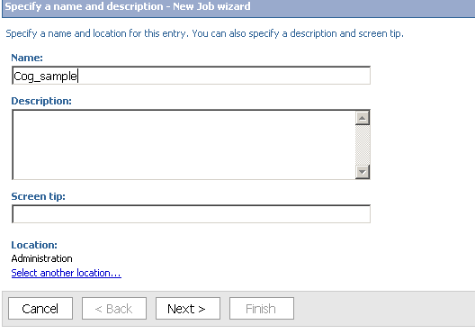
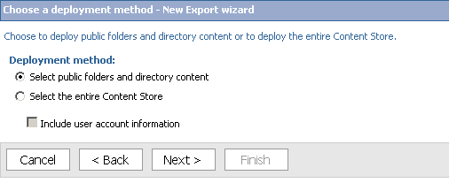
Cognos Competency integration * intelligence * insight

Slide 28
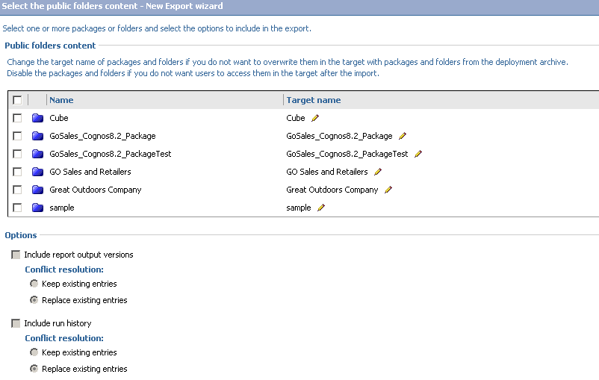
Cognos Competency integration * intelligence * insight

Slide 29
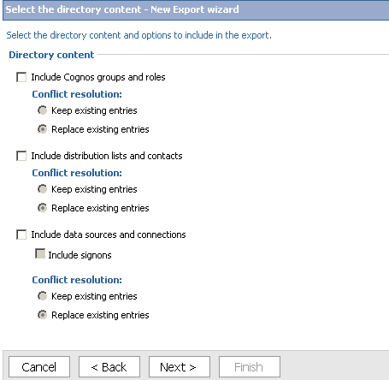
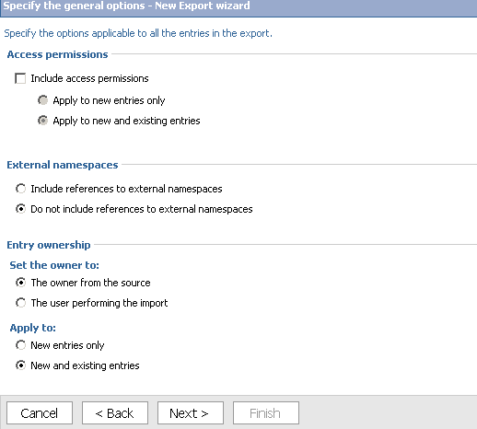
integration * intelligence * insight

Slide 30
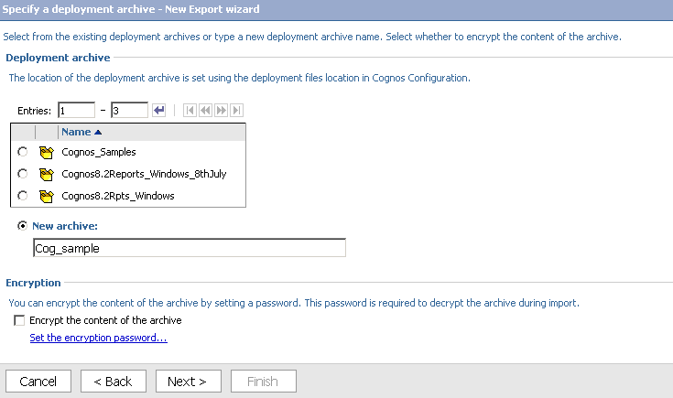
integration * intelligence * insight

Slide 31
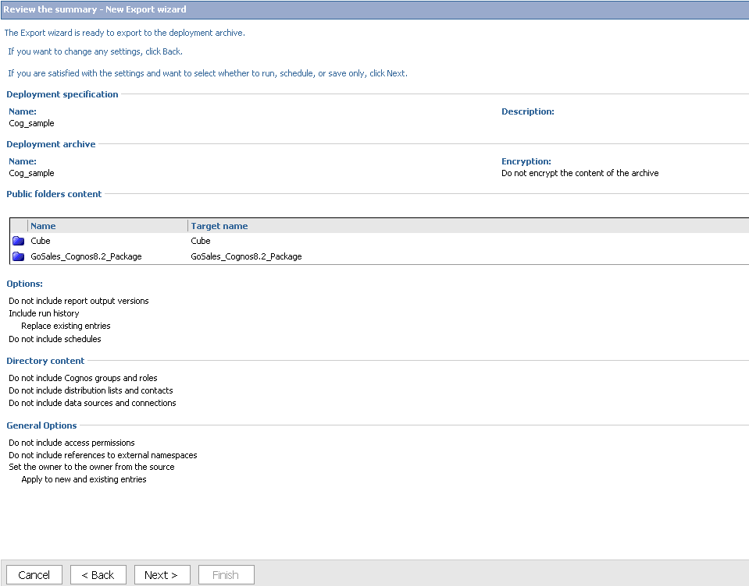
integration * intelligence * insight

Slide 32
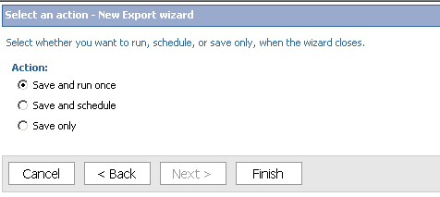
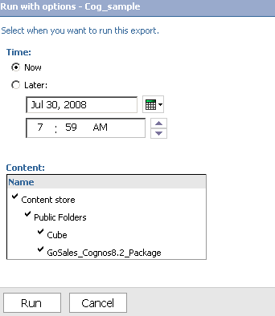
Deployment
integration * intelligence * insight

Slide 33
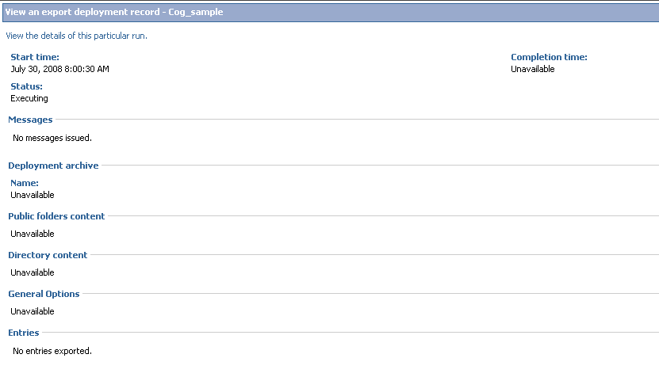
Deployment
integration * intelligence * insight

Slide 34
Audit Reports
Why Audit Report ??
To view the information in a logging database about user and report activity.
Some of benefits of auditing usage include:
Planning down time by identifying quiet periods.
Justifying additional infrastructure requirements.
Performance monitoring.
License conformance.
Identifying unused content.
integration * intelligence * insight

Slide 35
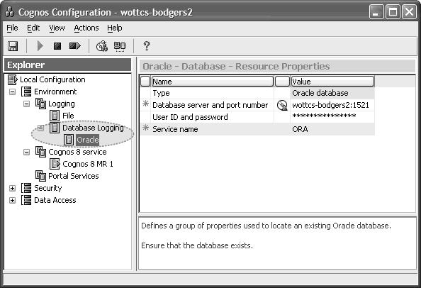
Audit Reports
Turning on logging to the Database
In Cognos Configuration, under Environment | Logging right-click and select New resourceDestination of the type Database and set up the connection to your chosen database accordingly.
Table get added as soon as start the cognos service
cogipf_action,
cogipf_agentbuild,
cogipf_agentrun,
cogipf_editquery,
cogipf_nativequery,
cogipf_parameter,
cogipf_runjob,
cogipf_runjobstep,
cogipf_runreport,
cogipf_sysprops,
cogipf_userlogon,
cogipf_viewreport
integration * intelligence * insight

Slide 36
Audit Reports
Cognos provide following sample Audit Report from audit package
    . Execute reports by package and report
    . Execute reports by package and report
    . Execution history by user
    . Logon operations by time stamp
    . Operations by selected object and users
    . Report execution history (detailed report)
    . Report execution history (summary report)
    . Report usage
    . User session - details
    . User session - logon error details
    . User session - logon errors for past 30 days chart
    . User session – summary
    . View reports by package and report
integration * intelligence * insight

Slide 37
Portal Services Administration
A portlet is a mechanism for displaying Web content as part of a portal page.
The Cognos portlets are available to users by default. If you want to make other portlets available, you must import them.
Managing portlets involves the following tasks:
• Importing portlets
• Controlling access to portlets
• Modifying portlets
integration * intelligence * insight
Notes:
Importing portlets : You can import third-party portlets into Cognos Connection if the portlets conform to the WSRP (Web Services Description Language) standard.
Controlling access to portlets : Control access to portlets by setting access permissions to specify which portlets are available to which users and what kind of actions the users can perform on a specific portlet. You can set access permissions individually for each portlet, or at the group level.
Modifying portlets : You can define the default content and appearance of portlets. The settings become the default for all users who use the portlet. You can lock the portlet for editing if you want to prevent other users from changing the settings.

Slide 38
Performance Monitoring and Tuning
● Databases
Keep your databases optimized for querying and reporting.
● Application servers
Adjust your application server memory and connection settings as required for better
performance.
● Web servers
Tune your Web server for maximum performance.
● Cognos 8
Monitor and tune various aspects of your Cognos 8 system.
integration * intelligence * insight
Notes:
Database :- Tune user database model from database administrator.
Application Server :- Change the memory setting as per Hardware support. Like Small , Medium and Large. Also configure the connection limit of application server.
Web servers:- The default Cognos 8 gateway is CGI, which can be used with all supported Web servers. For improved performance, consider using a scalable gateway, such as Apache mod for Apache and IBM HTTP servers, or ISAPI for IIS Web servers.
Cognos 8 :- Design Model/Package Rule
. Show only required data field.
. Use shortcut instead of new Query subject
. Use default filter in package
.Create calculation in package level
For report design select proper type of processing like Limited Local or Database only.
If Report have combination of chart and list than processing shoud be Limited Local only

Slide 39
Environment Sizing
Capacity Planning
  Cognos 8 users Sizing:-
  Estimate the number of Cognos 8 users you expect to have, and when you expect them to use Cognos 8.
  Application complexity sizing :-
  Assess the complexity of the processing that your users will demand of Cognos 8.
  Planning Infrastructure Components
  Content Store Sizing
  Scalability Planning
  Load Balancing
integration * intelligence * insight
Notes:
Capacity Planning : Planning for capacity means determining the hardware needed for your system to perform well under its anticipated workload.
Scalability Planning : Scalability is the ability of a system to adapt to increased processing demands in a predictable way, without becoming too complex, expensive, or unmanageable. As you deploy a system to larger numbers of users, often in different locations and time zones and with different language requirements, scalability becomes increasingly important.

Slide 40
Questionnaire for Sizing continued
Questions from Capacity Planning
  Total number of User ? Like Active User, Name User and Concurrent User
  For Eg
Total No of User | 1500
Name User | 1000
Active User | 100
Concurrent User | 10
For every 10 concurrent users that are simultaneously contributing
load on the system, there are typically 100 active users that are logged on to
the system out of 1000 named users that are licensed to use the system.
Ratio :- 1:10:100
integration * intelligence * insight

Slide 41
Questionnaire for Sizing continued
Questions from Capacity Planning
  What is the maximum number of queries that are run per hour?
Query Size/ Usage complexity | Small 1 – 100 Rows | Medium 101-1000 rows | Large 1001 or more rows
Low ***** | ------------ | ------------- | -----------------
Medium**** | ------------ | -------------- | -----------------
High***** | ------------- | -------------- | -----------------
integration * intelligence * insight
Notes:
Tip – Estimating the number of queries run per hour can be difficult. It may be helpful to think about the average number of queries that will be run by average Business Author multiplied by the peak number of active Business Authors on the system.
Low* = Refers to simple queries, no calculations, no exporting to rendered output format. The use of Design mode or paging through results is considered low complexity.
Medium** = Refers to average queries, some calculations included, no exporting to rendered output format. The use of Design mode to include expressions, calculations, summary filters and prompts can be considered medium complexity.
High*** = Refers to complex queries, calculations, possible export to a rendered output format, possible charting, and possible cross-tabs. Running queries to only make use of first page in a result set rather than paging through all pages of a result set.

Slide 42
Questionnaire for Sizing continued
Questions from Capacity Planning
  What is the maximum number of reports run per day?
Size/ Complexity | Small 1 – 10 Pages | Medium 101-100 Pages | Large 100 or more Pages
Low ***** | ------------ | ------------- | -----------------
Medium**** | ------------ | -------------- | -----------------
High***** | ------------- | -------------- | -----------------
integration * intelligence * insight
Notes:
Low* = Reports based on simple queries, little to no aggregation and little to no calculations.
Medium** = Reports of medium complex queries, some aggregation and some calculations.
High*** = Reports of highly complex queries, high aggregation and many calculations (requiring many computational operations).

Slide 43
Questionnaire for Sizing continued
Questions from Capacity Planning
  Report processing requirement :-
  This is identify by the report output and processing Type
Format / Processing Type | HTML | PDF | Excel
Low ***** | ------------ | ------------- | -----------------
Medium**** | ------------ | -------------- | -----------------
High***** | ------------- | -------------- | -----------------
integration * intelligence * insight
Notes:
Interactive - represent on-demand report runs whereby a user requires live data to appear in a pre-formatted report template. Typically, interactive reports are most useful to consumers accessing smaller and less complex reports (see Report Complexity Grid). This allows consumers to more effectively absorb information given a short interpretation period representative of most on-demand reporting.
Scheduled - represent report runs (preferably during off-peak hours) whereby user’s require event-driven information (for example, a previous day’s sales report to be ready for retrieval in the morning). The use of scheduled reports can maximize the effectiveness of viewing reports by distributing the processing required to run reports. This is especially important when considering the manner in which larger and more complex reports are required (see Report Complexity Grid).
Burst – represent report runs (preferably during off-peak hours) whereby multiple users require filtered data based on a pre-determined schedule (for example, quarterly financial results). Burst reports are used when a common report format is applicable to more than one recipient, but each recipient requires customized information based on their role.

Slide 44
Questionnaire for Sizing continued
Questions from Content Store
  What is the average number of saved reports per ReportNet user for each of the following report sizes: (e.g. 5 per user)?
  1 to 10 PDF pages: _____
  11 to 100 PDF pages: _____
  101 to 1000 PDF pages: _____
  What is the number of folders used to organize content in the ReportNet portal (a function of public folders and user-specific folders)?
  What is the number of Framework Manager models used to build reports and ad hoc queries?
integration * intelligence * insight

Slide 45
Questionnaire for Sizing continued
Questions from Hardware Sizing
  What is the preferred operating system platform for deploying web servers (e.g. Windows, Solaris, HP-UX, AIX, Linux)?
  What is the preferred web server software (e.g. IIS, Sun ONE, IBM/Apache)?
  What type of databases will be used as data sources for your Cognos application? (e.g. Oracle, DB2, Teradata, MS SQL Server)?
  What is the preferred operating system platform to deploy Cognos application servers (e.g. Windows, Solaris, HP-UX, AIX, Linux)?
  Installation is Standalone or distributed?
  What is the preferred web gateway technology (i.e. CGI, ISAPI, servlets, Apache Mod)?
  Are you planning to deploy the application within an Intranet or Extranet environment?
integration * intelligence * insight

Slide 46
Recommendation for Sizing
Understand the Peak period to schedule the report
Daily:
Start 9 am 12 pm 3 pm 5 pm End
Rating: 3 5 3 0 1 3 5 3 1
Reasons: Daily requirement to view reports.
Weekly:
Start Sunday Monday Tuesday Wednesday Thursday Friday Saturday End
Rating: 1 5 4 3 2 3
Reasons: Weekly requirement to view and assess sales targets (conducted predominately on Tuesdays and Thursdays).
Identify the relative peak usage rating using a scale from 0 (lowest) to 5 (highest)
integration * intelligence * insight

